Slide 1


Solar Power Generation Prediction Project
-Predicting Solar Energy Output Using Machine Learning Techniques
Presented by –
MA RAHMAN

Slide 2
Content:
Objective and overview of project
Tools and platform used
Methodology –
  Data Collection
  Exploratory Data Analysis (EDA)
  Regression Analysis Methodology
  Model Implementation
  Model Evaluation
  Results and Interpretation
  Model Selection
  Deplyoment
Conclusion

Slide 3
Objective and overview of project
In this project, we focused on predicting solar power generation using regression techniques. Our goal was to develop a machine learning model that could accurately forecast the amount of electricity generated by solar panels based on various factors. To achieve this, we followed a two-step process:
Model Development: We experimented with different machine learning algorithms to identify the one that produced the most accurate predictions. This involved training several models, evaluating their performance, and selecting the best-performing one based on accuracy metrics.
Model Deployment: Once we identified the most accurate model, we deployed it for practical use. This meant integrating the model into a working system where it could be used to make real-time predictions about solar power generation.

Slide 4










Tools and Platform used
Tools: Python
Platform: Jupyter Notebook, Spyder.
Libraries used: NumPy, Pandas, Seaborn,scikit-learn,Matplotlib,Streamlit.

Slide 5
Process flow
Data Description
Exploratory Data analysis (EDA)
Model Building
Model Selection
Deployment
Conclusion

Slide 6
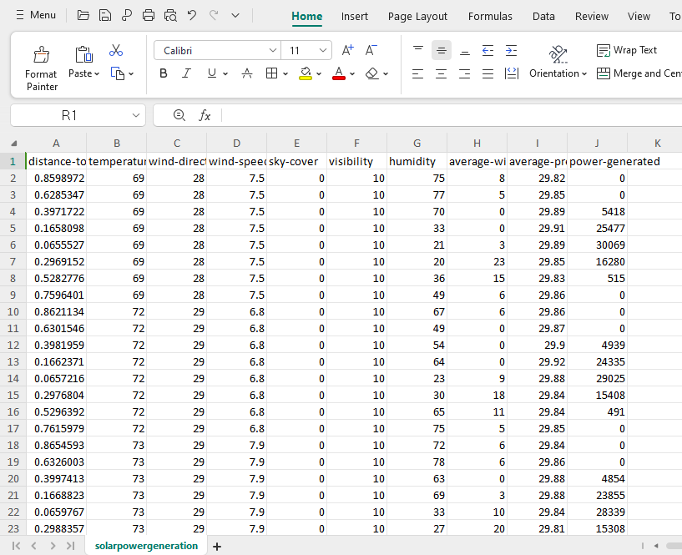
Methodology
1. Data collection – dataset description
Data Source: The dataset used for this project was provided by our mentor.
Content of the Data: The data includes various factors influencing solar poer generation, such as distance-to-solar-noon, temperature, wind-direction, wind-speed, sky-cover, visibility, humidity, average-wind-speed-(period), average-pressure-(period),and power-generated.
Number of columns is 10 and number of rows is 2920.
Initial Data Review: Preliminary checks were conducted to ensure the data's relevance and quality before proceeding with further analysis.

Slide 7
2. Exploratory Data Analysis (EDA)
Steps taken in exploratory data analysis (EDA) :
Summary Statistics- Provided a concise overview of the data distribution's central tendencies, dispersion, and shape, including mean, median, variance, and range measures.
Missing value imputation -Identified missing values in the average wind speed (period) column and filled them with the median of the column to preserve data integrity.
Outlier Detection and Treatment -Outliers were detected using the IQR method and capped at Q1 - 1.5IQR and Q3 + 1.5IQR to prevent skewed model performance.

Slide 8
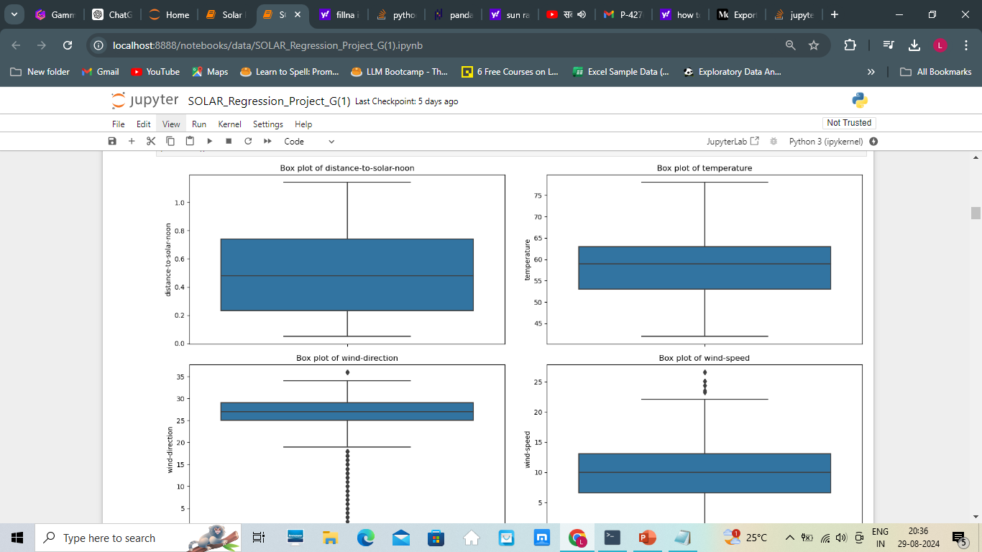
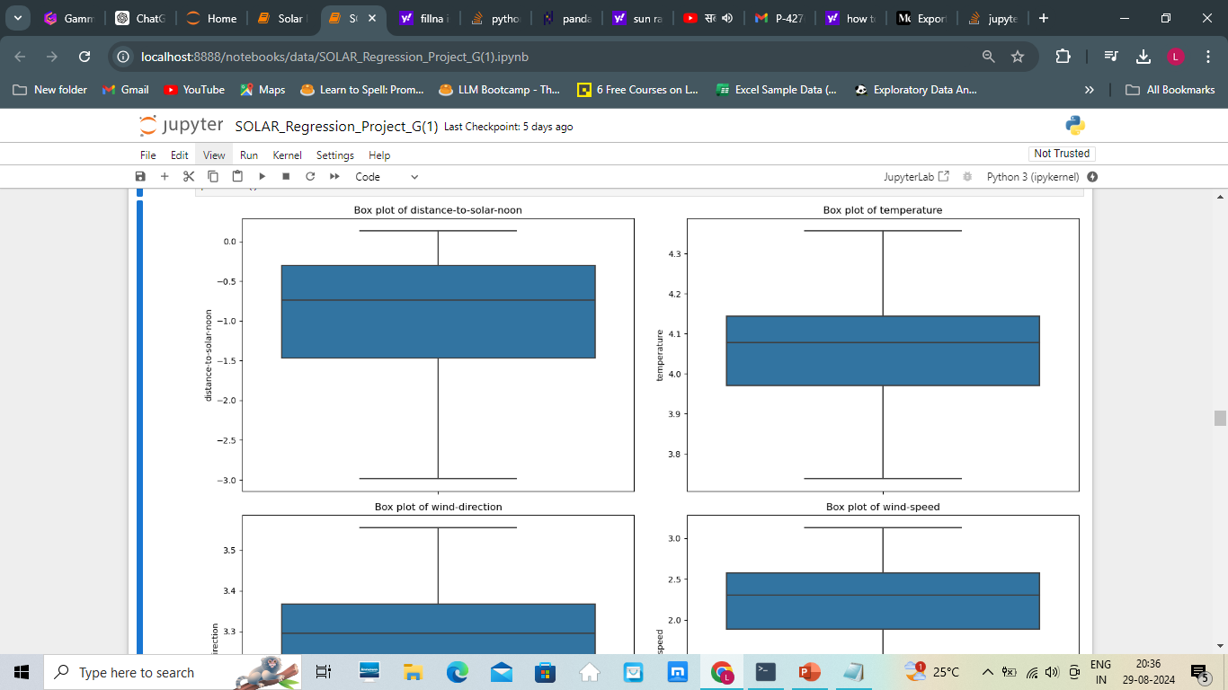
Outliers before capping
Outliers after capping

Slide 9
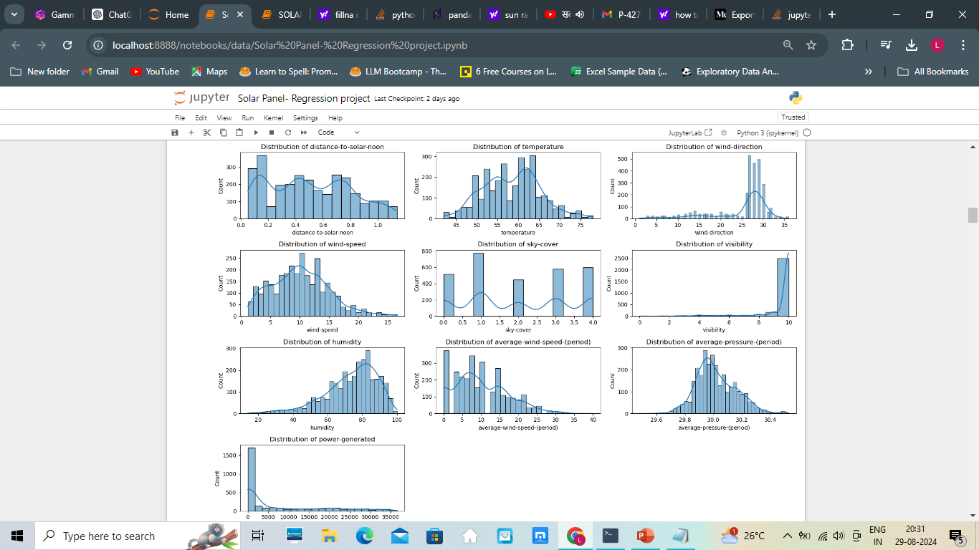
Histplot showing skewness of data

Slide 10
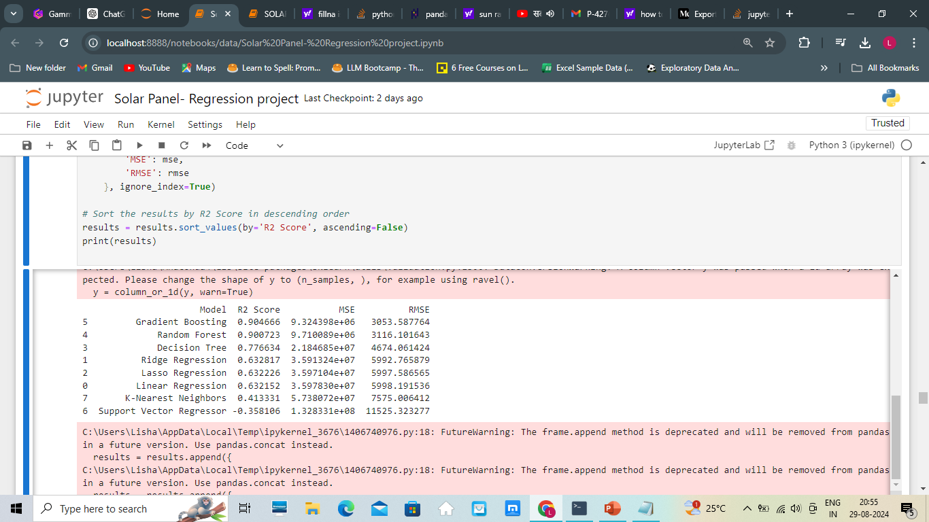
3. Regression Analysis – Model Building
Data splitting – 70% train and 30% test data.
Model Building – Models build to test: LinearRegression(), 'Ridge Regression’, 'Lasso Regression' , 'Decision Tree', 'Random Forest’, 'Gradient Boosting', 'Support Vector Regressor', 'K-Nearest Neighbors’ , to find the best fit for the data.
Result of all models-

Slide 11
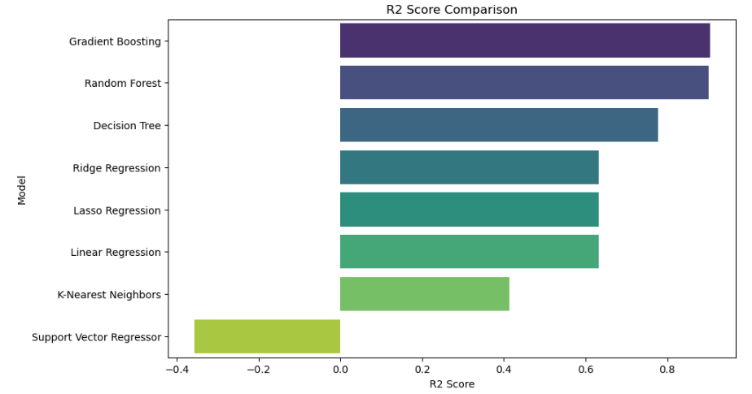
Based on the results, the Gradient Boosting model gave the highest R2 score (0.904627) and the lowest MSE and RMSE values among all the models tested.

Slide 12

4.Hyperparameter tuning
Used GridSearchCV to optimize the hyperparameters of the Gradient Boosting Regressor.

Slide 13
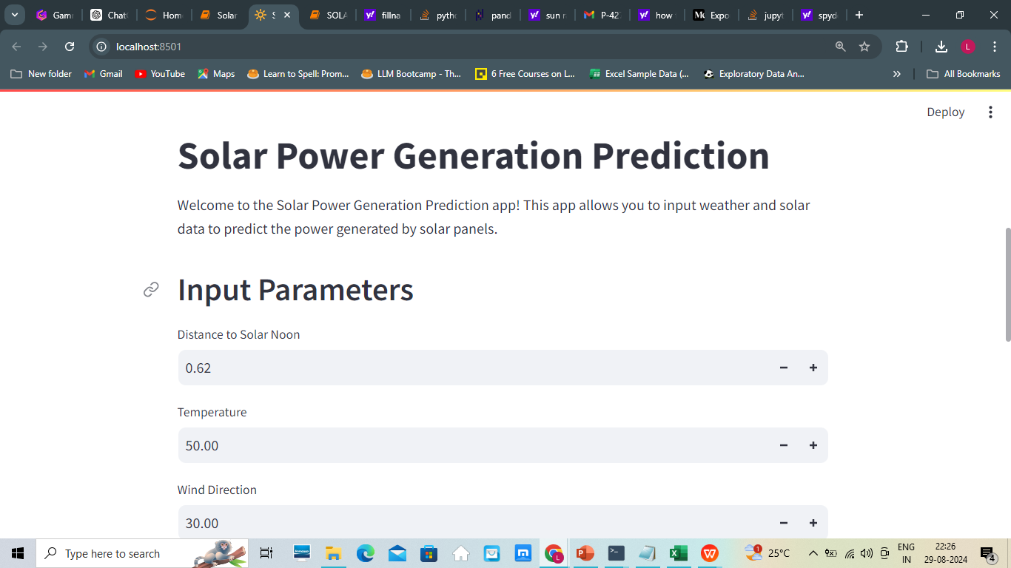
4. Model Deployment
Deployment Method: The trained Gradient Boosting Regressor model is deployed using Streamlit for an interactive user experience.

Slide 14
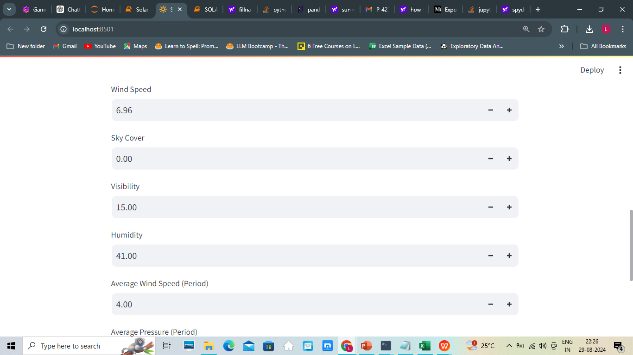

Slide 15
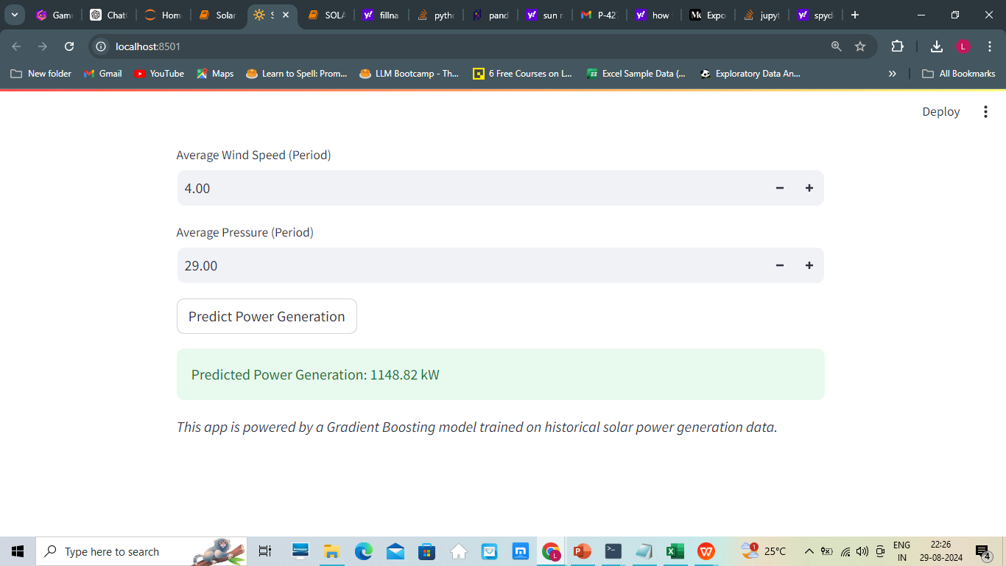

Slide 16
5.Conclusion and Future Work
The project has helped us create an accurate and reliable machine learning model for predicting solar power generation. This model can greatly improve energy management by delivering precise solar power predictions. It holds potential for integration into smart grid systems, optimizing energy distribution and minimizing waste.
Future work – It includes updating the model with new data, exploring advanced models like XGBoost or neural networks, and applying it to large-scale solar farms and smart grid systems for daily energy predictions and real-time management."

Slide 17
THANK YOU………

